Slide 1
Let’s Talk about Long Covid.

Slide 2
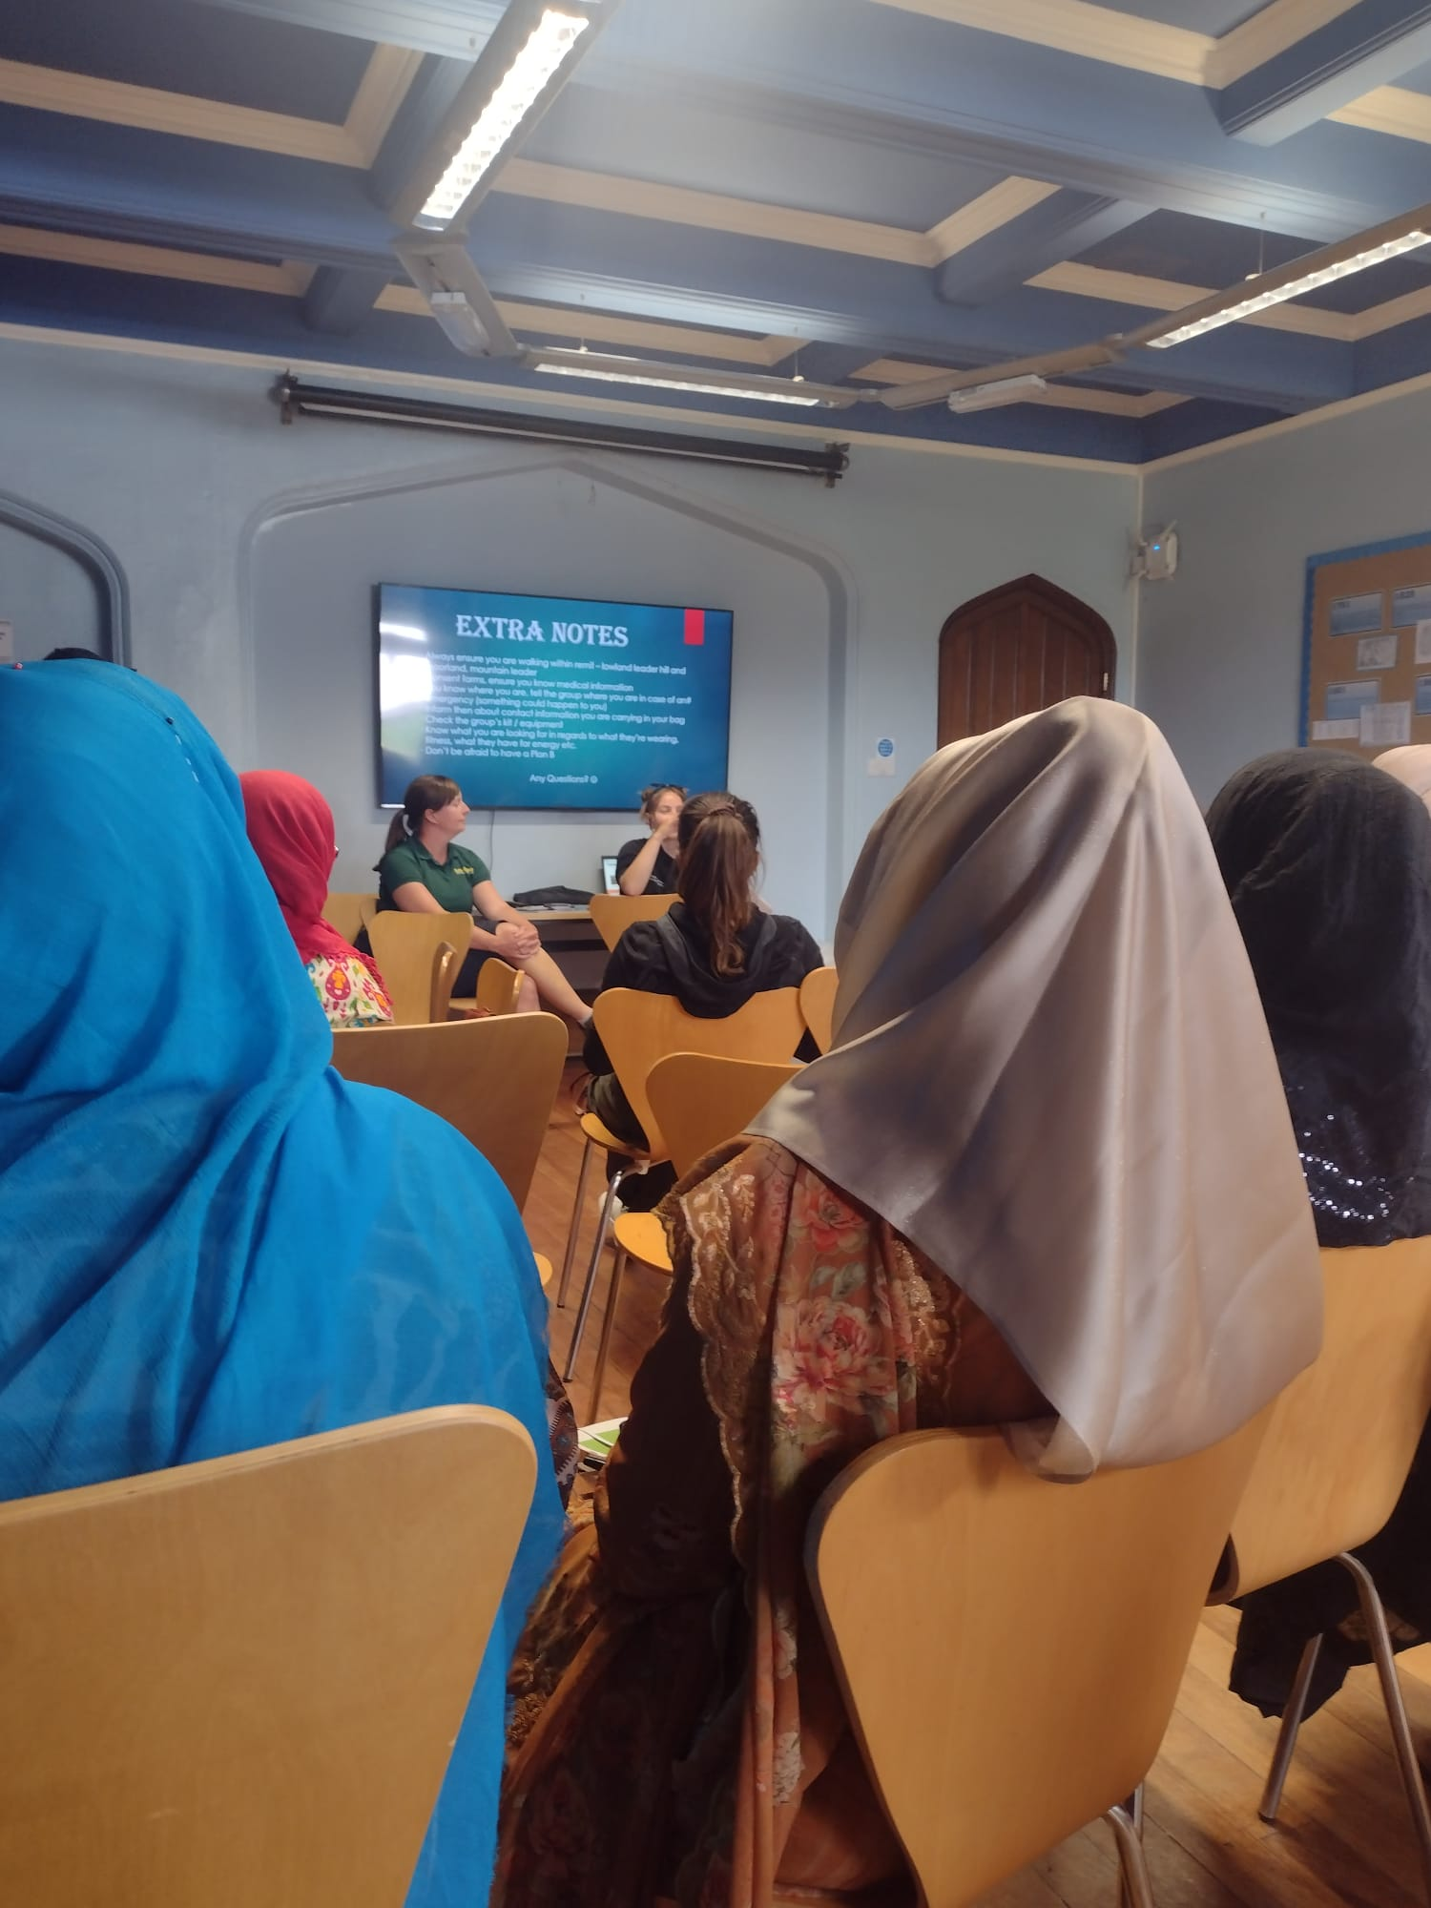
What we will cover in today’s session.
What are the signs of Long Covid.
When Do I need to get help
WHAT IS AVAILABLE
What Is Long Covid
Who do I need to go to

Slide 3
What is Long Covid?
Most people who have had Covid-19 feel better within a few days or weeks and make a full recovery.
For some people, symptoms after their infection can last longer than 12 weeks. This is called Long Covid.
Long Covid can sometimes be difficult to diagnose, especially if you have had other health issues. Some people might not realise that their symptoms may be linked to the Covid-19 infection.
Symptoms can come and go and new ones appear weeks or months later.
Some people may not be aware that they have had Covid-19. Some may not have had symptoms at the time of infection or might not have had a test.

Slide 4
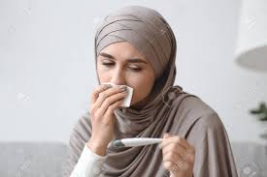
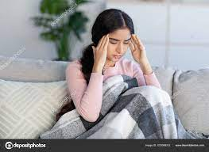
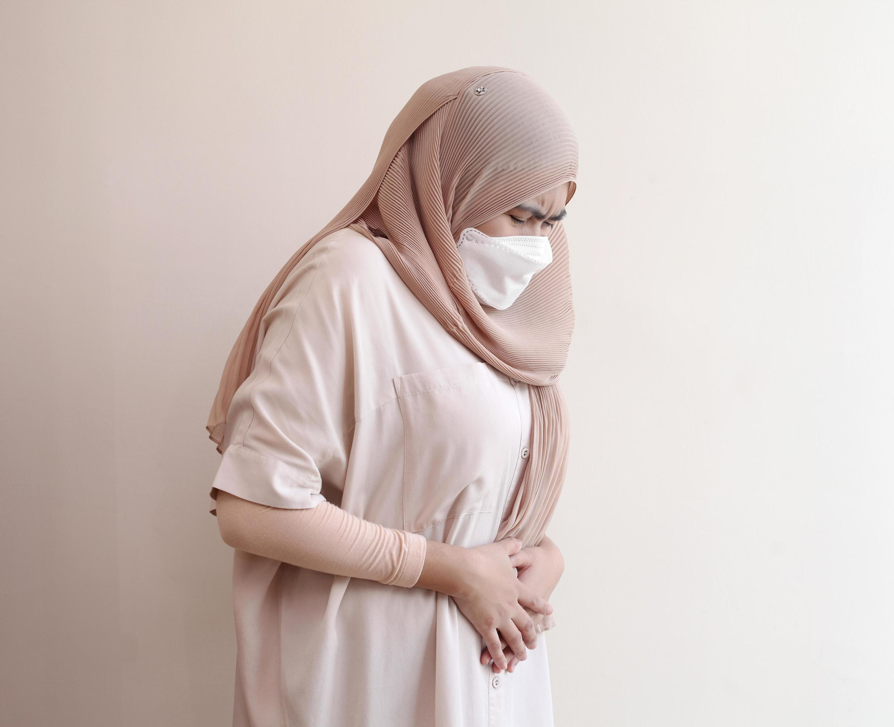
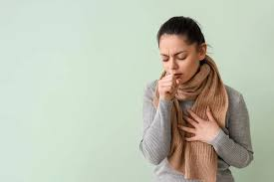
What are the signs of long Covid.
The most common signs of long COVID are:
Feeling tired all the time
Feeling short of breath
Loss of smell and taste
Muscle aches
Loss of concentration
Forgetting things
Chest pain or tightness
Difficulty sleeping
Fast beating heart
Joint pain
Depression and anxiety
Earaches/ ringing ears
Diarrhoea
Stomach aches
Not feel like eating
High temperature
Cough
Headaches
Sore throat,
Rashes
Contact a GP if you've had symptoms of COVID-19 for 4 weeks or more and are worried.

Slide 5
WHO DO I NEED TO GO TO?
The symptoms you can get after COVID can feel worrying and you might need help to manage them. If the Symptoms last for more than four weeks, you should get medical advice.
Contact your GP if there are any new symptoms or current symptoms that are getting worse following the COVID-19 infection. Especially if the symptoms have been present for 4 weeks or more.
If your symptoms are mild, your GP may offer simple self-management advice.
Your GP will want to make sure that there are no other more serious reasons for your symptoms. They may ask you to complete some tests.
Once they have received your results and found that there are no other reasons for your symptoms, they might suggest a referral to the Long Covid Rehabilitation Hub – this is a specialist service in Sheffield that supports people with Long Covid.

Slide 6
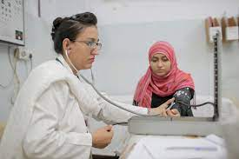
DON’T FORGET
For urgent medical help - use the NHS 111 online service or call them on 111 if you’re not able to get help online
For life-threatening emergencies – call 999 for an ambulance

Slide 7
What groups are available to support you with Long Covid?
Useful national websites that will give you more information about Long Covid and point you towards the right support for you:
Your COVID recovery – www.yourcovidrecovery.nhs.uk
My long covid needs – www.mylongcovid.org.uk
Long covid support – www.longcovid.org
Local support available in Sheffield:
Darnall Well Being host a monthly Long Covid Support Group at Darnall primary Care Centre. Booking is essential if you want to join their meeting – contact them on 0114 2496315 or email: dwb.enquiries@darnallwellbeing.org.uk
The Sheffield ME and Fibromyalgia group provide support to people with Long Covid – contact them on 0114 253 6700 or through their website: www.sheffieldmegroup.co.uk
SOHAS (Sheffield Occupational Health Advisory Service) can provide advice on work-related health issues – contact them on 0114 275 5760 or through their website: www.sohas.co.uk

Slide 8
THANK YOU FOR LISTENING.
DO YOU HAVE ANY QUESTIONS?

